Slide 1
CS 341 Lab 9
Fall 2020

Slide 2
Lab 9
Goal: Determine whether an object is moving closer or away

Slide 3
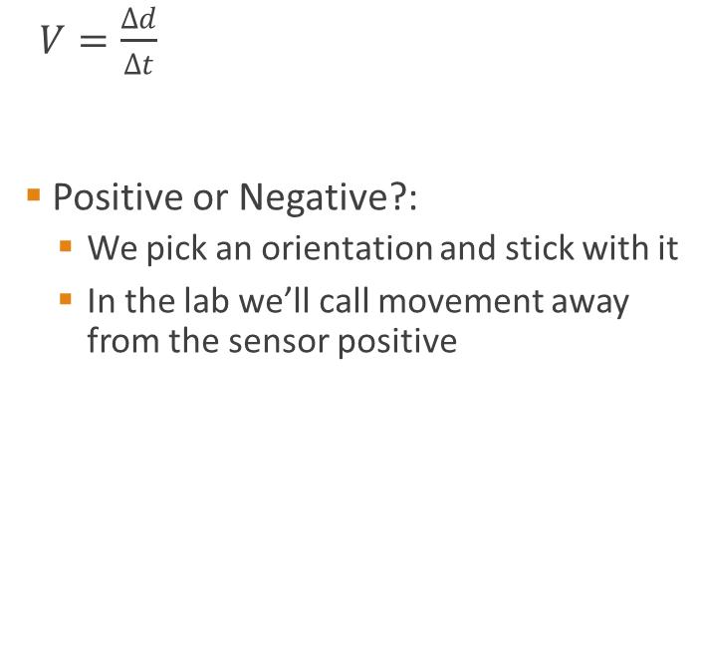
Velocity
$V=\frac{∆d}{Δt}$
Positive or Negative?:
We pick an orientation and stick with it
In the lab we’ll call movement away from the sensor positive
Distance d

Slide 4
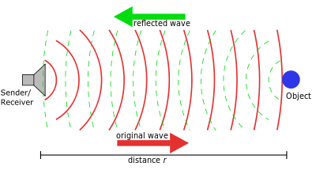
Sonar

Slide 5
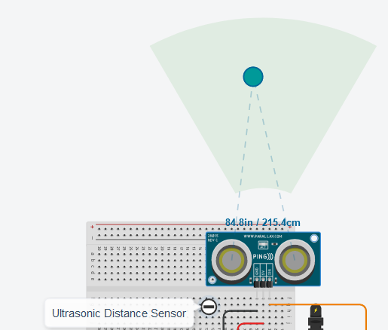
Distance Sensor
inputs a digital input
High means send out a signal
Low means don’t send a signal
outputs a digital signal
The length of this signal is equal to how long the it took to get a response
Make sure to use the sensor with 3 pins (not 4)

Slide 6
Ping()
int ping(int pingPin) {
int duration;
pinMode(pingPin, OUTPUT);
digitalWrite(pingPin, LOW);
delayMicroseconds(2);
digitalWrite(pingPin, HIGH);
delayMicroseconds(5);
digitalWrite(pingPin, LOW);
pinMode(pingPin, INPUT);
duration = pulseIn(pingPin, HIGH);
return duration / 29 / 2;
}
PulseIn
Returns the pulse width (length of time in ms a digital pin is high for)
Analog input
Value between [0, 1023] based on voltage in [0, 5V]
Send a signal out
Record time
Divide by V_{sound}⁻¹
Divide by 2

Slide 7
Lab 9
The starter code already finds the distance of an object
use the ping() function to estimate the velocity over time
Suggestion: calculate velocity as a float

